Slide 1

Recommendation using Collaborative Filtering
By
Chris Alexander
Viveka Salinamakki

Slide 2

What is a Recommendation System?
Predicts/Recommends the products or services that users would buy or consume
Used in e-commerce, entertainment content, social media posts, advertisements, music, etc
Types of recommendation
Collaborative-based Filtering
Content-based Filtering

Slide 3
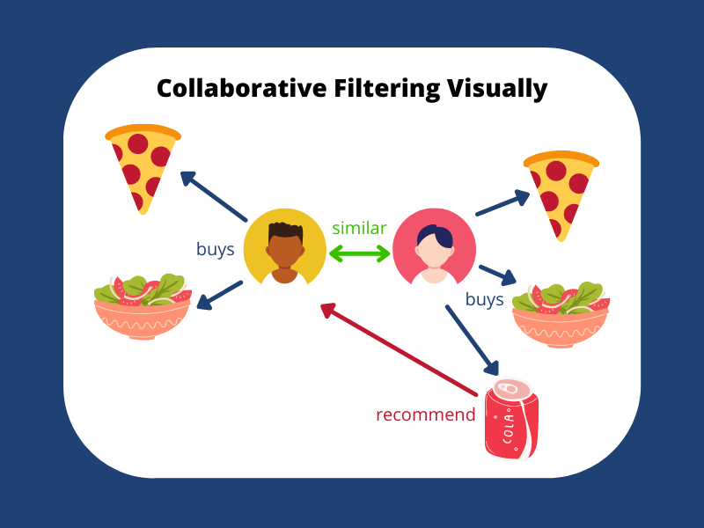
What is Collaborative Filtering?
Finds similar patterns among users
Filters out items that users like based on the ratings or reactions of similar users

Slide 4

Types of Collaborative Filtering
Based on User similarity
Based on item similarity
Find users sharing similar rating patterns with test user
Ratings from these users used to calculate a prediction
Relationships among items found using item-item matrix
Match user’s data with this matrix to get preferences

Slide 5
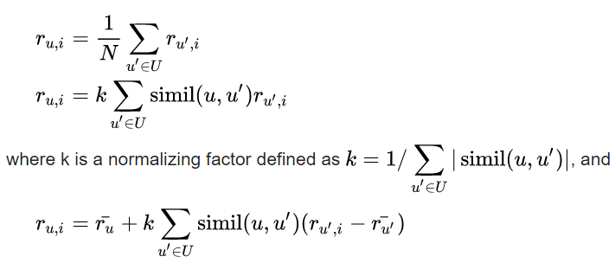
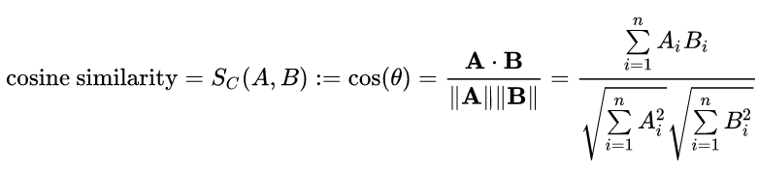
Similarity Check
Similarity can be computed as follows
Source
Source

